Slide 1
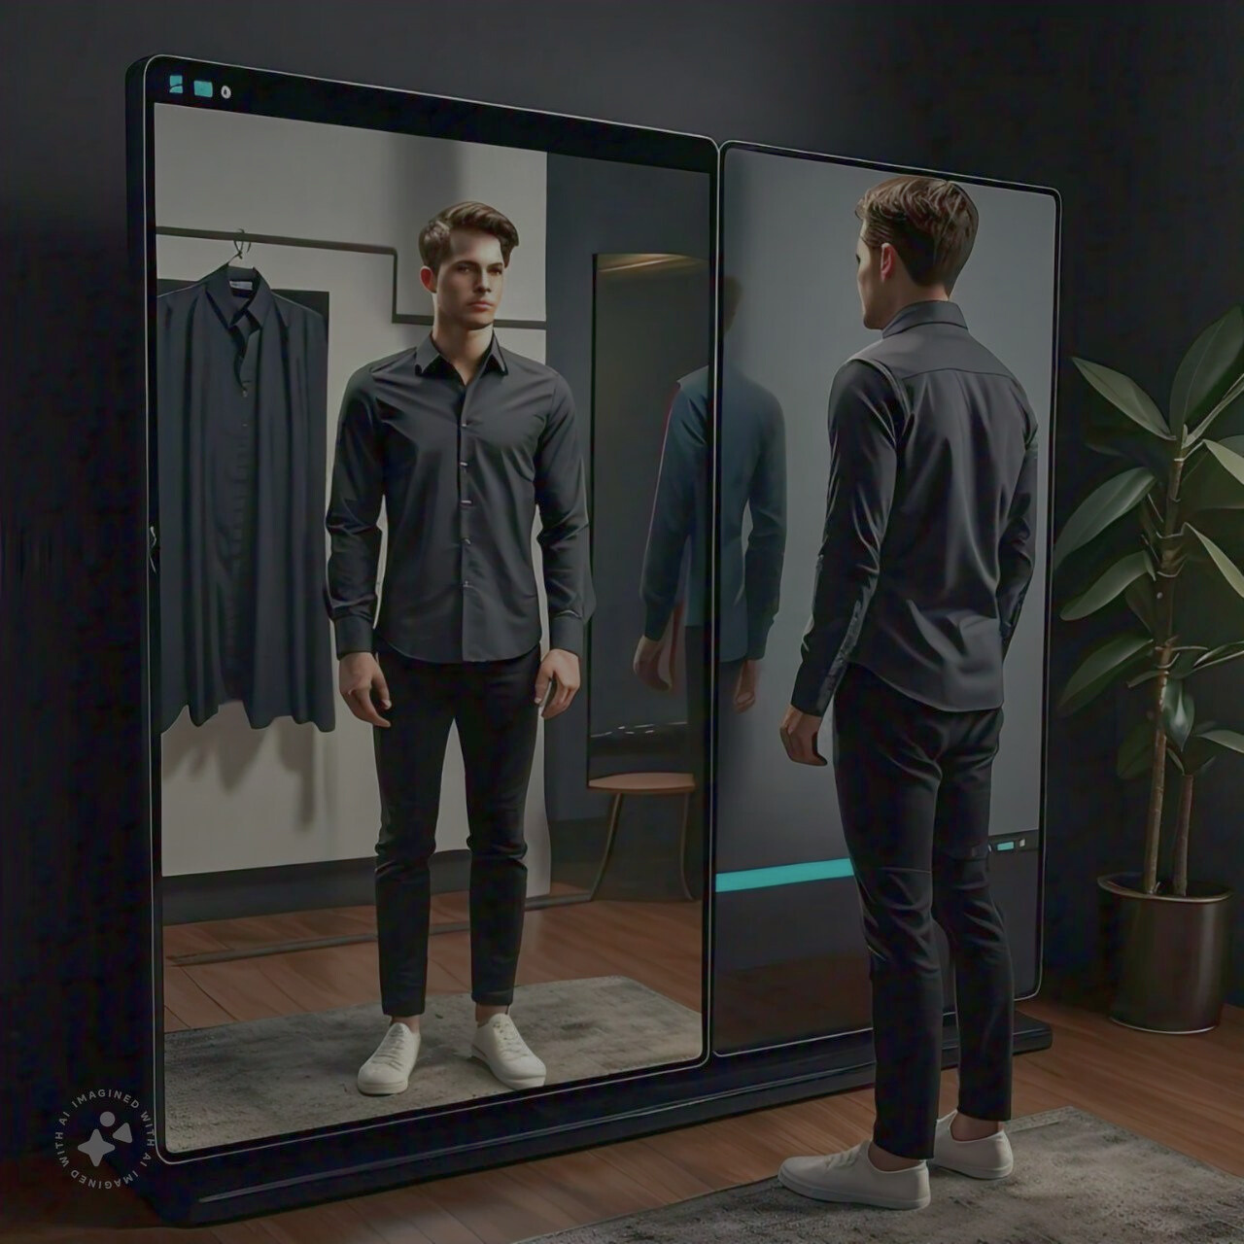



SHRIDEVI HACKATHON 2024
VIRTUAL SHIRT TRY-ON
Theme - Environment
Team Members - chinamuthevi Aparna
kode Devi Sri Vallika
Jampala Nithish Kumar
College Name- Seshadri Rao Gudlavalleru Engineering College
SHRIDEVI NATIONAL LEVEL HACKATHON - 2024

Slide 2

PROBLEM STATEMENT
E5
VIRTUAL SHIRTS TRY ON
User Image Capture: Capture the user's upper body using a webcam or uploaded image.
Pose Detection: Use pose estimation (e.g., MediaPipe) to identify key points, especially shoulder positions, for proper shirt placement.
Shirt Image Overlay: Overlay a pre-designed shirt image with transparency (PNG format) onto the user's body, aligning it with detected key points. Resize based on shoulder width.
Alpha Blending: Use the shirt’s alpha channel for smooth blending with the user’s image, maintaining a realistic look.
Simple Interface: Display the result in real-time using OpenCV, allowing users to switch shirts and sizes interactively.
SHRIDEVI NATIONAL LEVEL HACKATHON - 2024
2

Slide 3


E5
TECHNICAL APPROACH
Programming Languages:python
Frameworks and Libraries:OpenCV,MediaPipe
SHRIDEVI NATIONAL LEVEL HACKATHON - 2024
SHRIDEVI NATIONAL LEVEL HACKATHON 2024
3

Slide 4
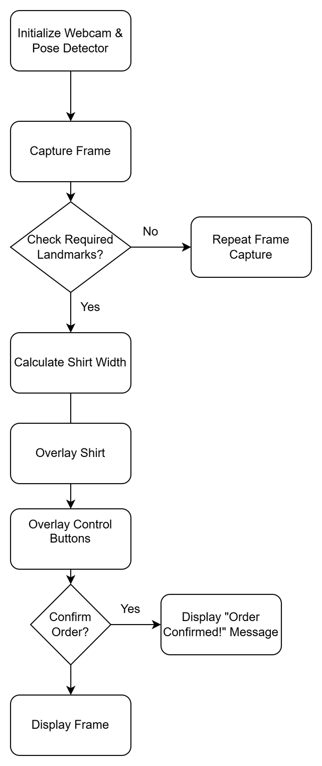
Flow Diagram Visualization
E5
SHRIDEVI NATIONAL LEVEL HACKATHON - 2024

Slide 5
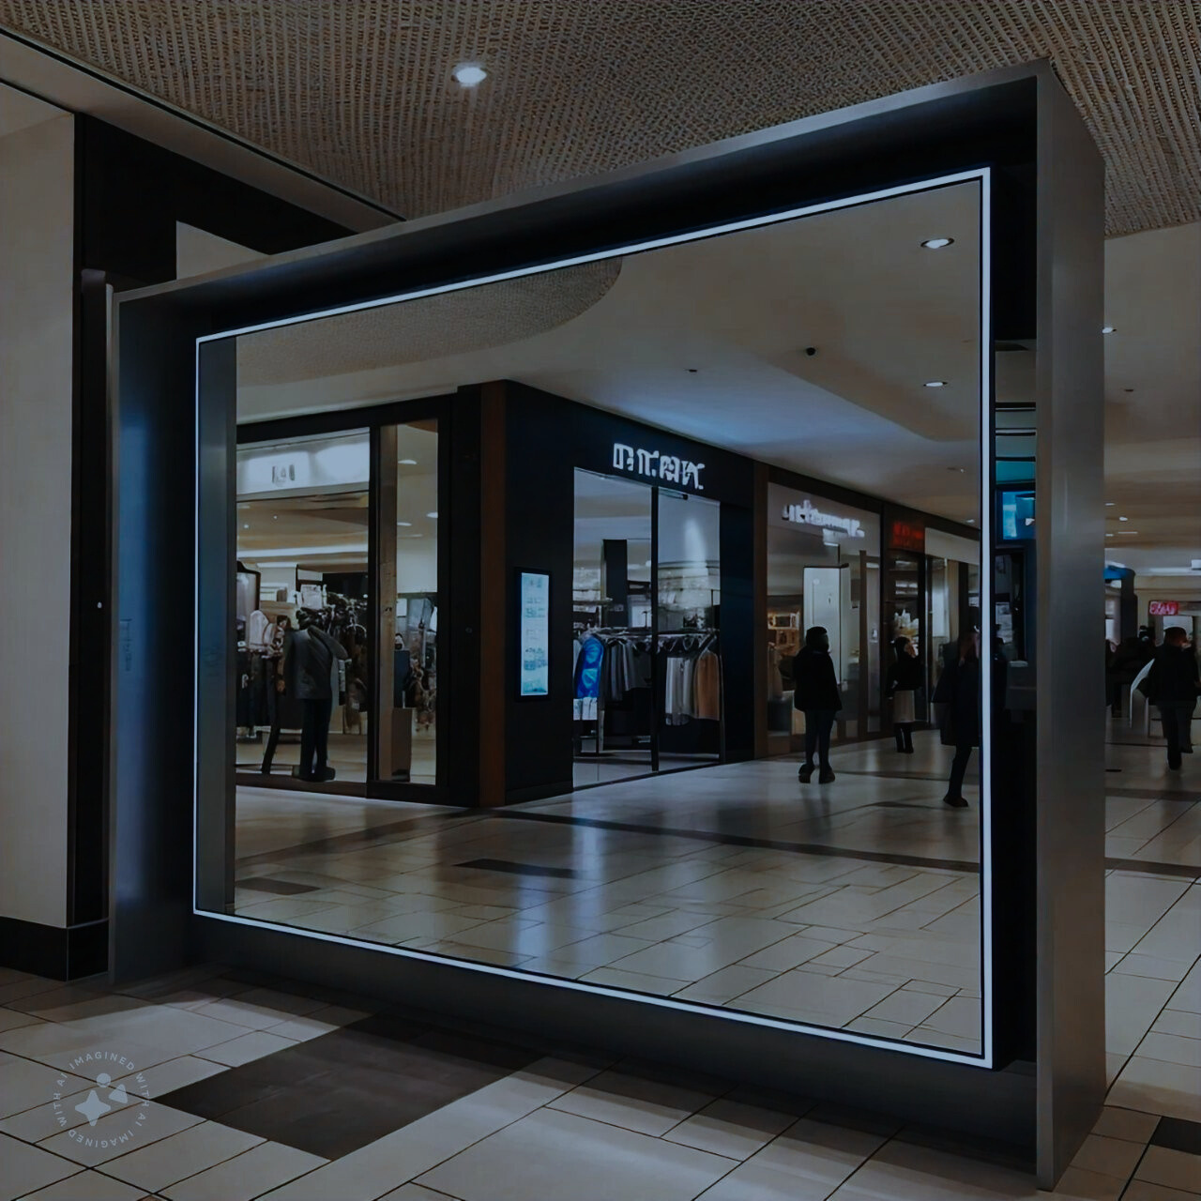
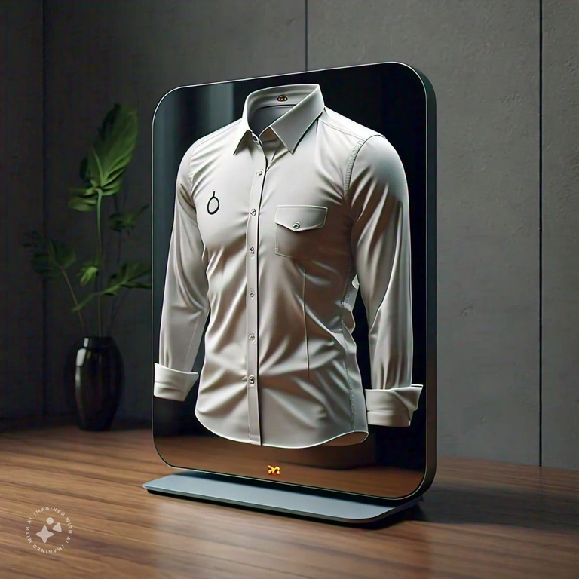
FEATURES
E5
Real-Time Gender Detection
Accurate Pose Detection
Gesture-Based Navigation
Dynamic Shirt Overlay
Visual Feedback
SHRIDEVI NATIONAL LEVEL HACKATHON - 2024
4
SHRIDEVI NATIONAL LEVEL HACKATHON - 2024

Slide 6
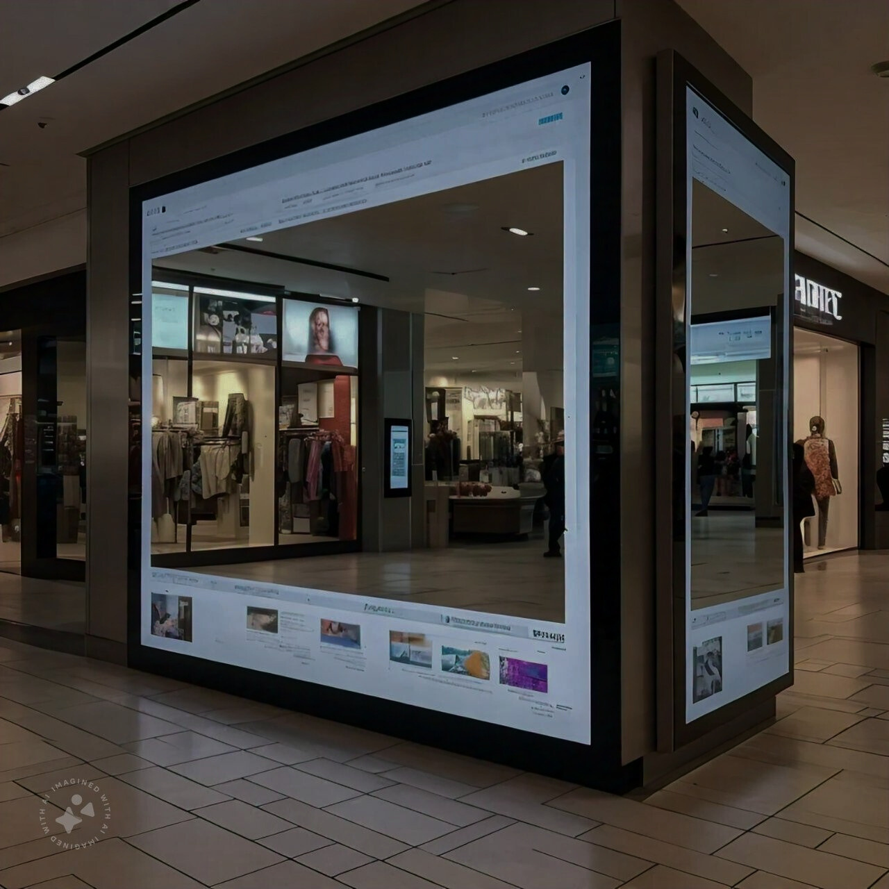
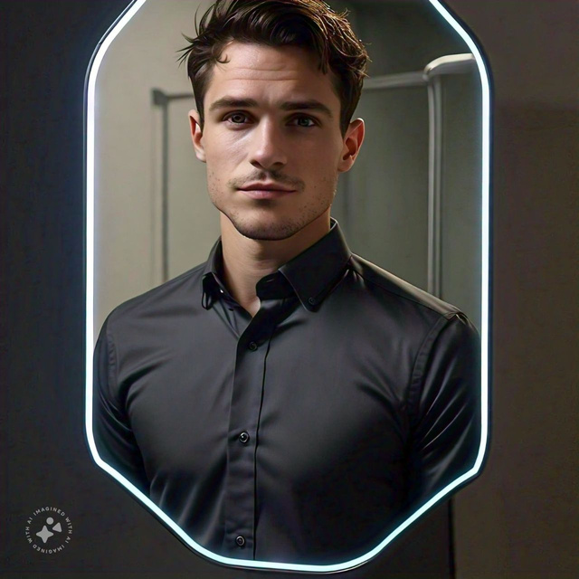
E5
CHALLENGES FACED
Lighting Conditions
Real-Time Processing
User Positioning
Gesture Recognition Accuracy
Model Performance
SHRIDEVI NATIONAL LEVEL HACKATHON - 2024

